Slide 1

How to Save and Hand in Files in Drive
For Digital Art and Photography
This Activity addresses the following Print Ed. Competencies
Advertising Design - Section A Orientation - 4

Slide 2
Setup Your Drive
Use the BIHS Google Drive account to create a folder that is named “Your Name Digital Art and Photography”. This will be where you store your documents for this course and the artwork for your Weebly website.

Slide 3
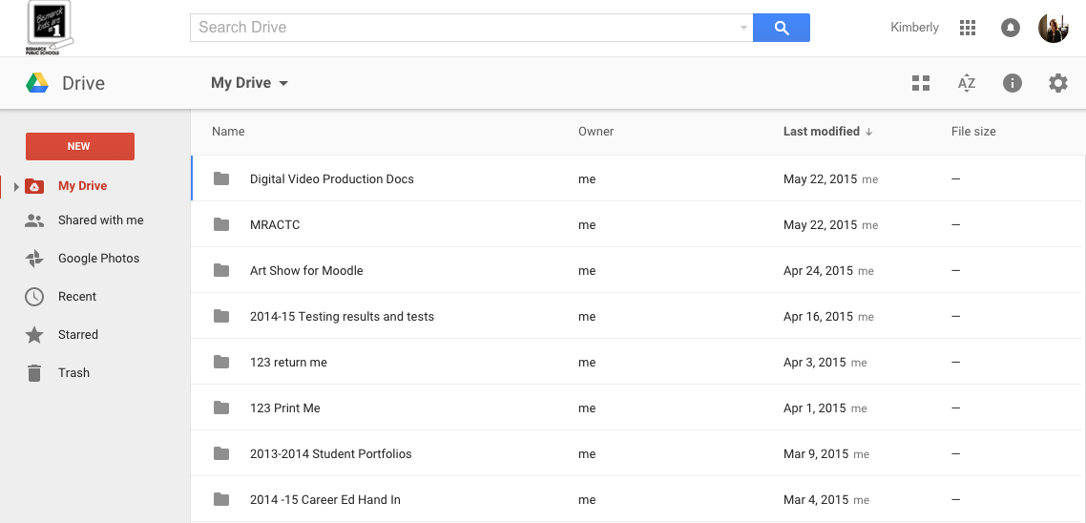
Setup Your Drive
Your drive should look like this. You might see some pretty old stuff in here if you don’t visit often.
Under the “New” button you should see 6 options. Each of them will allow you to look at the files and folders in your drive differently. If you do not have much in your drive you won’t see a lot of change in your drive’s content but try each of the options and get to know your drive.

Slide 4
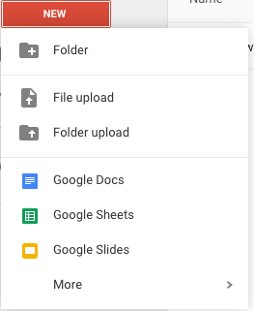
Setup Your Drive
Click on the “New” button and choose the “New Folder” option.

Slide 5

Setup Your Drive
Name your folder “Your Name Digital Art and Photography”, This will be where you will store all of your finished files. These files will be used as evidence that you have completed labs, projects and tutorials. You might also want to put your assessment and quiz scores here as well.

Slide 6
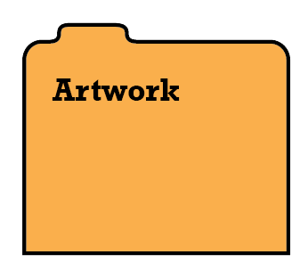




Setup Your Drive
Completed digital artwork such as logo and t-shirt designs should go here.
In order to keep your work organized, you will need to create 5 new folders inside of your portfolio folder. In theory your portfolio will look like this:
Work orders for each project that you attempt should be in here.
Thumbnails for each project should be scanned and stored here.
Assessment and Quiz scores should go here.
Photos that you take and edit should go here.

Slide 7


Setup Your Drive
You will also need to create a directory document and you should also have the most recently updated I Can lists in your portfolio. These documents should be the only ones outside of a folder. When I open your portfolio, this is what I should see:
Folders

Slide 8
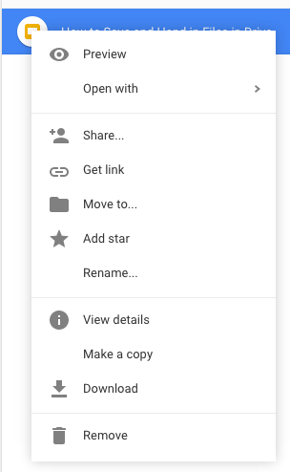

Share Your Drive Folder
To share anything in Drive, You either right click on that folder, document or presentation and choose the share option or…
when the item is open, you click on the blue “Share” button on the upper right.

Slide 9
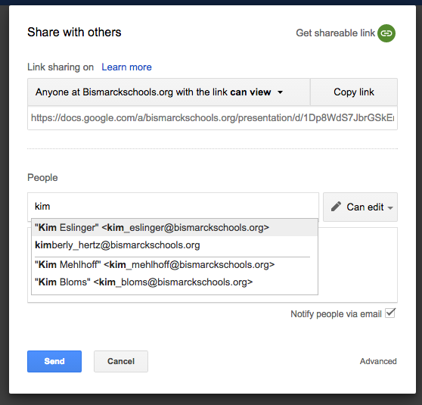
Share Your Drive Folder
A dialog box will appear and you will need to set up your folder so that “Anyone at Bismarckschools.org with a link can view.
Choose me typing my name in the people window.
Make sure that you choose the Can Edit Option.
When you are finished with this activity be sure to let me know.
Hit the “Send” button.

